Slide 1
Quest Hunt
Rajashekar Gande
Ravichander Reddy

Slide 2
Objective
To understand the full stack application development
Playing a quest game where it has two colors
When the user touches the first color, it would request a valid location.
And by touching the second color, the user gets information whether they have reached the quest.

Slide 3
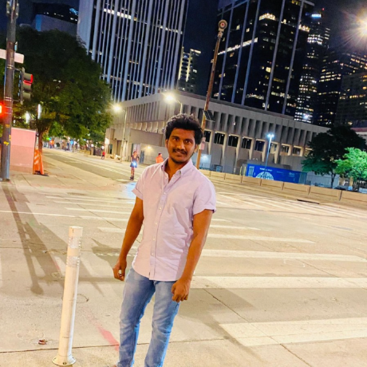
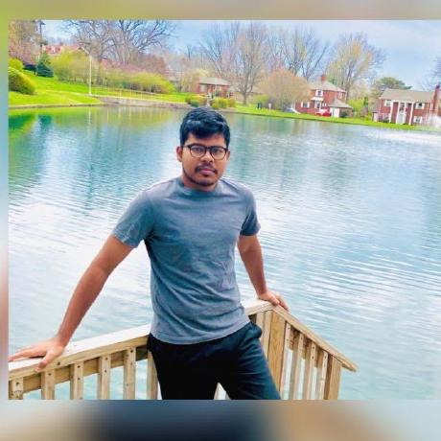
About Us:
Rajashekar Gande
https://github.com/Rajshekar2641
Ravichanderreddy Goli
https://github.com/Ravichanderreddy-goli

Slide 4
Technology Stack
Front end: ReactJS
Database: MongoDB
Backend: ExpressJS
IDE: VSCode
Platform: Web Application
Deployment: Heroku
Environment: Nodejs

Slide 5
Published App
App deployed on Heroku
https://questhunt-frontend.herokuapp.com/

Slide 6
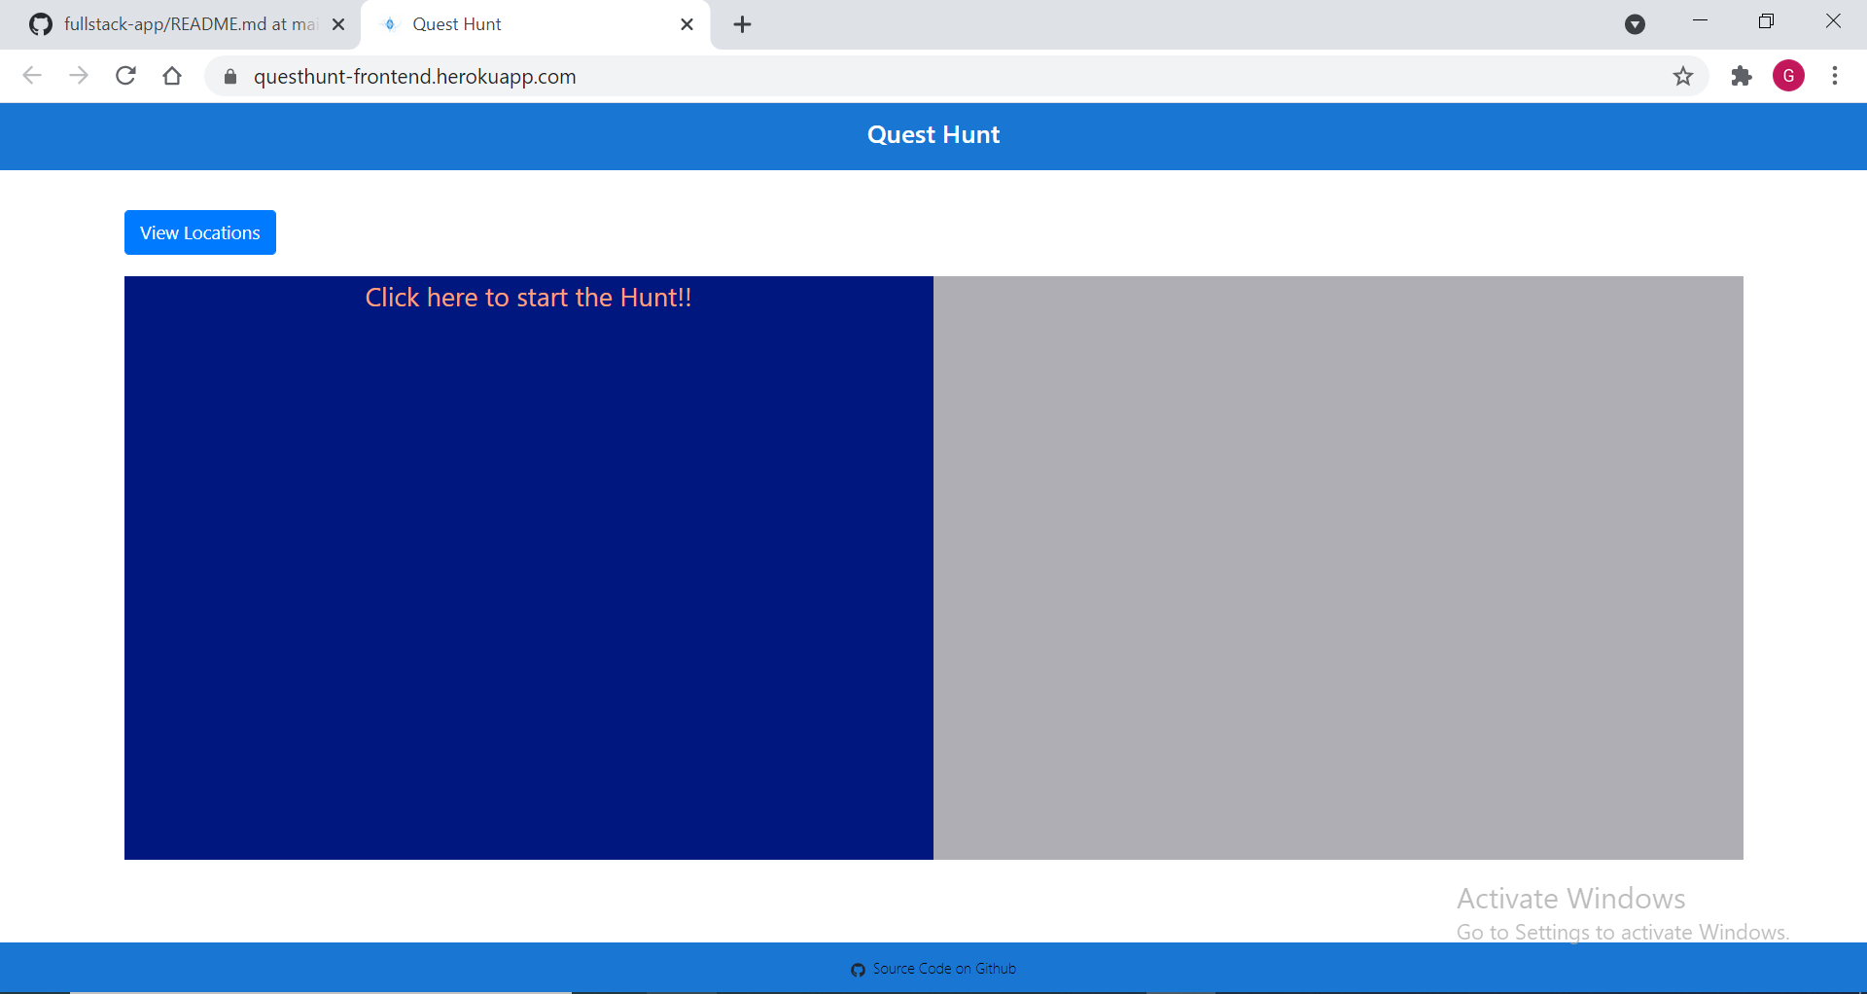
App Screenshots

Slide 7
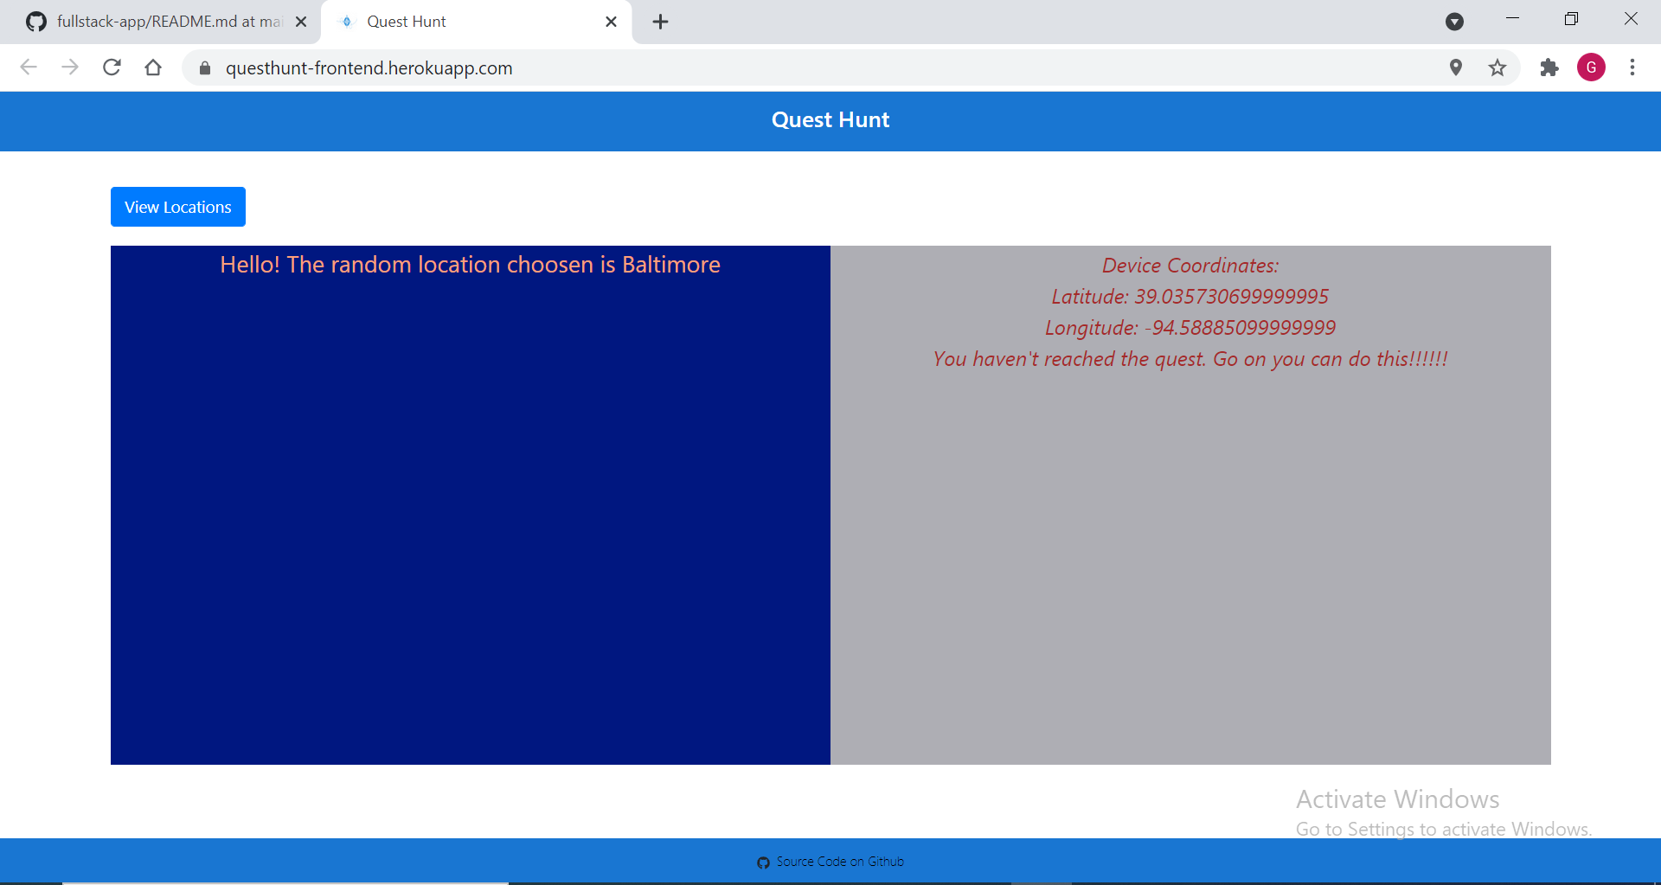

Slide 8
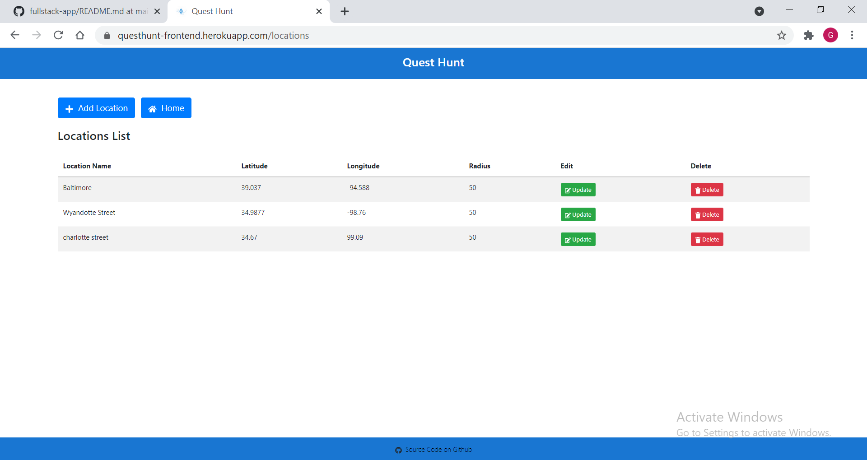

Slide 9
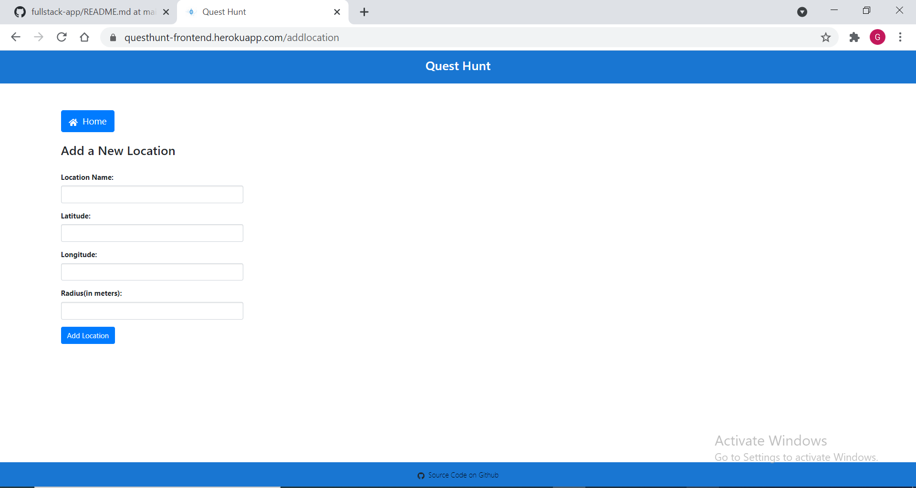

Slide 10
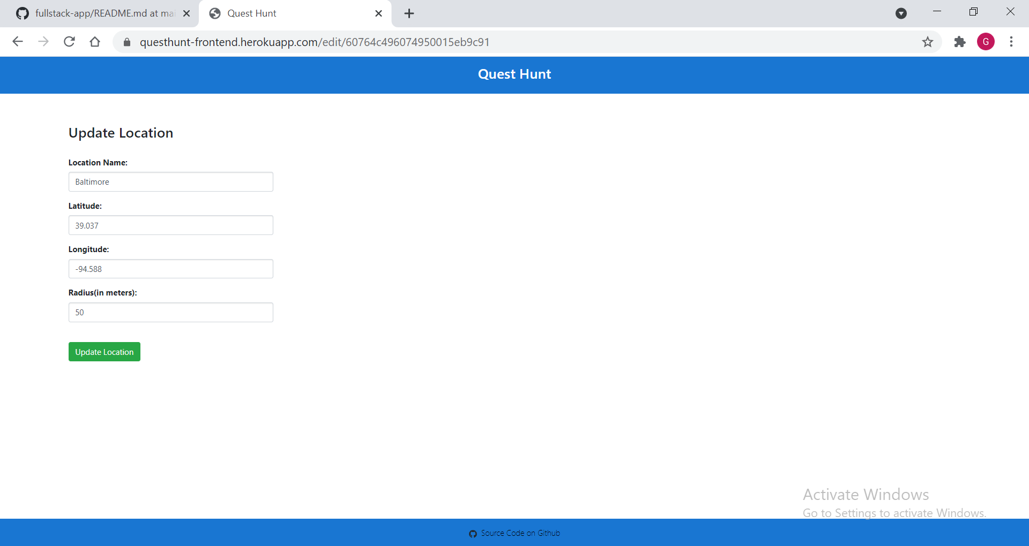

Slide 11
